Slide 1
Hybrid Voxel Neural Field
Advanced Computer Graphics
Final Project
Presenter: Jun Suk Ha

Slide 2
Graphics?
Notes:
To help audience understand project’s goal and process

Slide 3
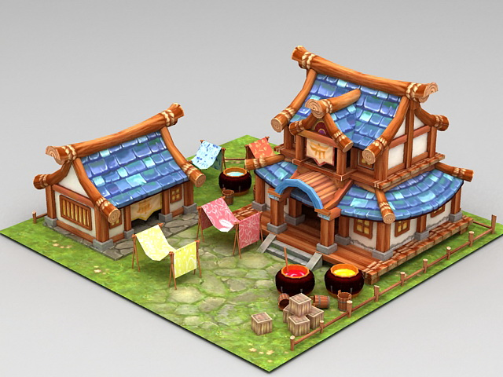
Graphics?
Image Formation
Graphics

Slide 4
Graphics? Inverse Graphics?
Image Formation
Graphics

Slide 5
Graphics? Inverse Graphics?
Image Formation
Inference
Neural Scene
Representation
Downstream Tasks
Graphics
Inverse Graphics

Slide 6
Graphics? Inverse Graphics?
Image Formation
Inference
Neural Scene
Representation
Downstream Tasks
Navigation
Graphics
Inverse Graphics

Slide 7
Graphics? Inverse Graphics?
AR/VR
Image Formation
Inference
Neural Scene
Representation
Downstream Tasks
Navigation
Graphics
Inverse Graphics

Slide 8
Graphics? Inverse Graphics?
3D Reconstruction
AR/VR
Image Formation
Inference
Neural Scene
Representation
Downstream Tasks
Navigation
Graphics
Inverse Graphics

Slide 9
Graphics? Inverse Graphics?
3D Reconstruction
AR/VR
Image Formation
Inference
Neural Scene
Representation
Downstream Tasks
Navigation
Dynamic reconstruction
Graphics
Inverse Graphics

Slide 10
Graphics? Inverse Graphics?
3D Reconstruction
AR/VR
Image Formation
Inference
Neural Scene
Representation
Downstream Tasks
Navigation
Image Synthesis
Dynamic reconstruction
Graphics
Inverse Graphics

Slide 11
Graphics? Inverse Graphics?
3D Reconstruction
AR/VR
Image Formation
Inference
Neural Scene
Representation
Downstream Tasks
Navigation
Image Synthesis
Dynamic reconstruction
Graphics
Inverse Graphics

Slide 12
Goal?
Notes:
Why am I telling you what inverse graphics is? It’s related with my goal of this project

Slide 13
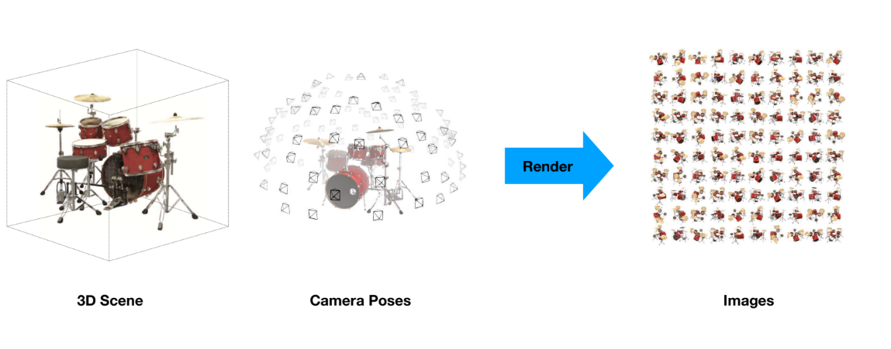
Graphics (Rendering):
Given 3D Scene + Camera Parameters yield images

Slide 14
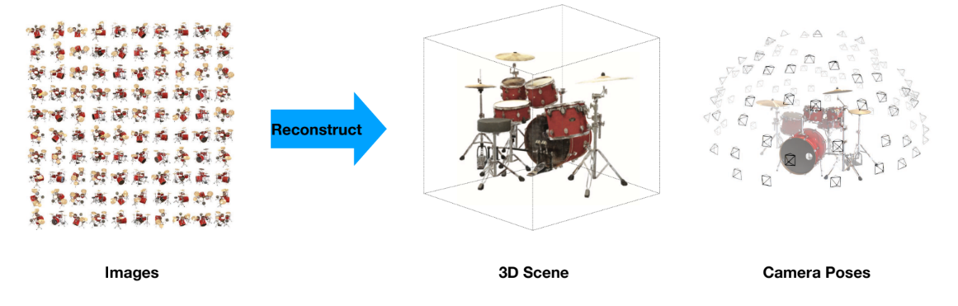
Inverse Graphics (Reconstruction):
Given Images Infer Camera Poses & 3D Scene!
Notes:
Here, although I say we can infer camera poses, there’re some models that infer camera poses, but in this project, assume camera poses are given
Emphasize no 3d shape is given

Slide 15
How?

Slide 16
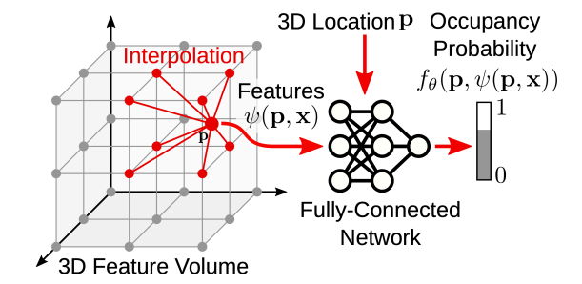
Hybrid Voxel Neural Field (Hybrid Field)

Slide 17
Hybrid Field + Occupancy Field

Slide 18
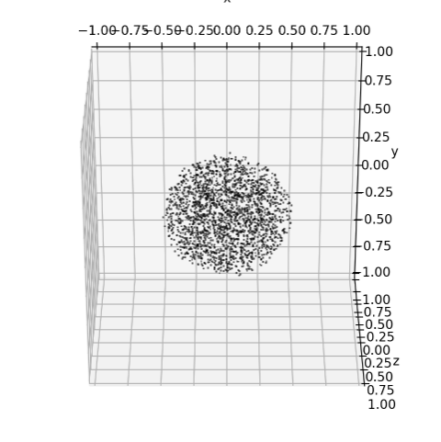
Hybrid Field + Occupancy Field of Sphere

Slide 19

Hybrid Field + Occupancy Field of Sphere

Slide 20
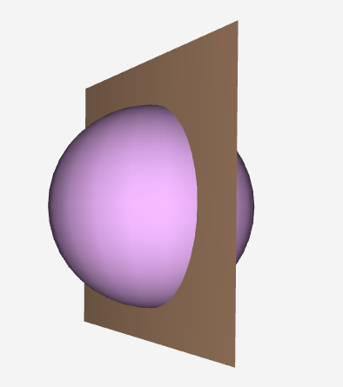
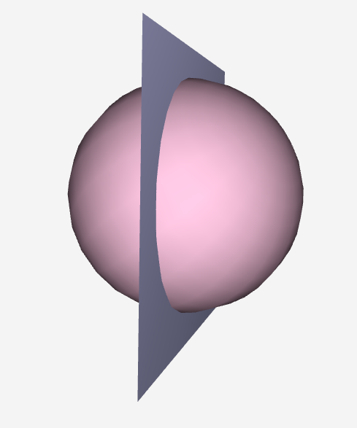
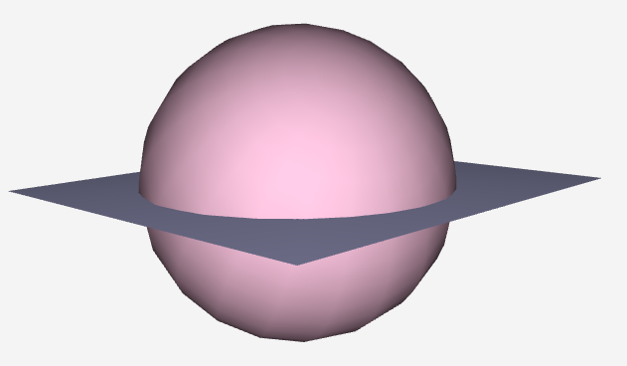
Feature Voxel Grid Training of Sphere Occupancy
axes[0].imshow(out[:, :, half_res, 0].squeeze().cpu())
axes[0].imshow(out[:, :, half_res, 0].squeeze().cpu())
axes[0].imshow(out[:, :, half_res, 0].squeeze().cpu())

Slide 21
Hybrid Field + Occupancy Field

Slide 22
Hybrid Field

Slide 23
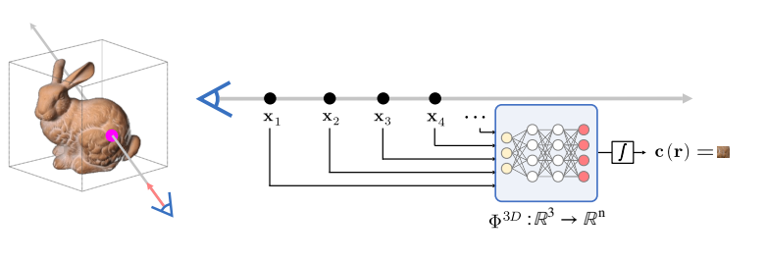
Hybrid Field + Volume Rendering

Slide 24
Hybrid Field + Volume Rendering

Slide 25
Result

Slide 26
Why so low quality Jun?
Notes:
Splendid 3d scene isn’t the goal of this project. Making model work is.

Slide 27
Why so low quality Jun?
Lower Image Resolution (128 * 128)

Slide 28
Why so low quality Jun?
Lower Image Resolution (128 * 128)
Simpler Model (e.g. # of parameters)
Notes:
The goal of this project was not to render a splendid image. The goal was to make the model work.

Slide 29
Why so low quality Jun?
Lower Image Resolution (128 * 128)
Simpler Model (e.g. # of parameters)
Positional Encoding (PE)
Notes:
Not gonna explain what PE is, but will show you how important it is instead

Slide 30

Left: Dataset Image | Middle: w/ PE | Right: w/o PE

Slide 31
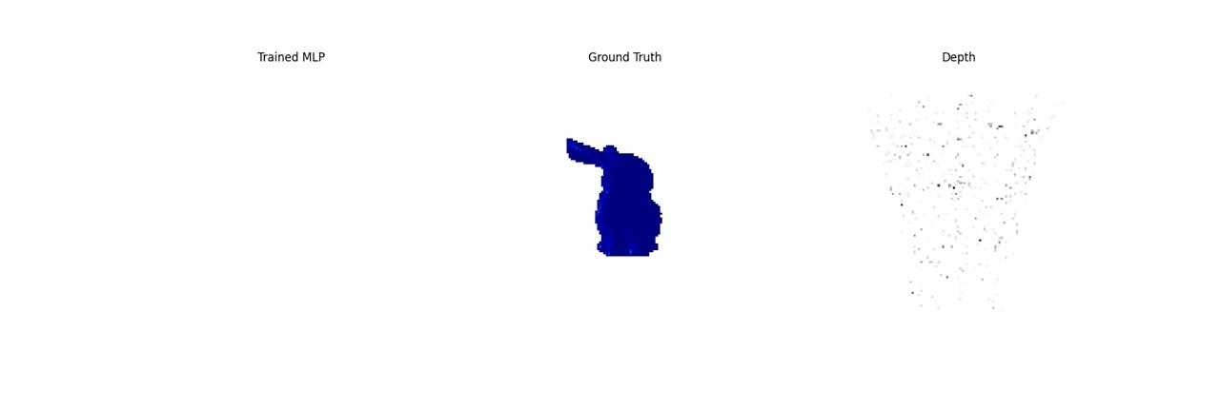
Hybrid Field Training w/ 20 images

Slide 32
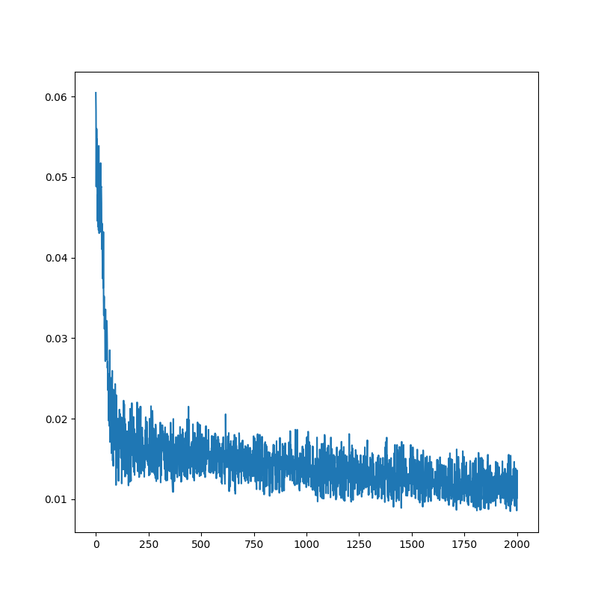
Hybrid Field Voxel + Neural) Training 20 images

Slide 33

Rendering Novel Views of Bunny
Notes:
It would have been better if I added ground truth images next to it

Slide 34
Eh

Slide 35
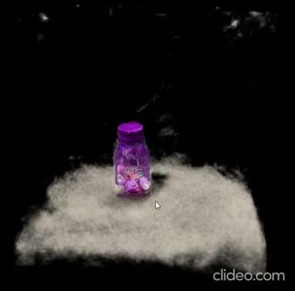
Different Model (Instant NGP w/ 30 images)

Slide 36
Roles
Idea: Jun
Code: Jun
Slides: Jun
Presentation: Jun

